Slide 1
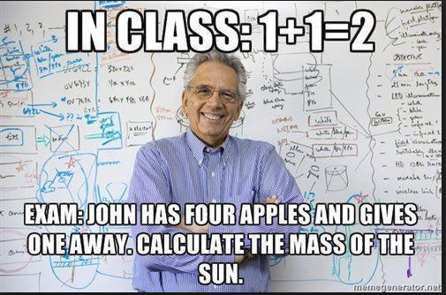

Slide 2
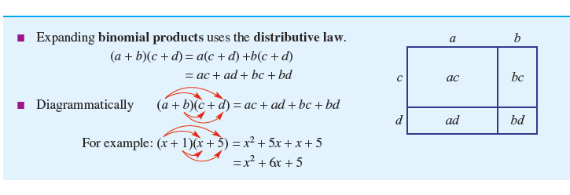


24
7
30
Expanding Algebraic Expressions
Date
EQ – How can I expand a binomial expression graphically?

Slide 3
24
7
30
Expanding Algebraic Expressions
Date
EQ – How can I expand a binomial expression graphically?

Slide 4
24
7
30
Expanding Algebraic Expressions
Date
EQ – How can I expand a binomial expression graphically?

Slide 5
24
7
30
Expanding Algebraic Expressions
Date
EQ – How can I expand a binomial expression graphically?
Use the FOIL method
First
Outside
Inside
Last

Slide 6
24
7
30
Expanding Algebraic Expressions
Date
EQ – How can I expand a binomial expression graphically?
Use the FOIL method
First
Outside
Inside
Last

Slide 7
24
7
30
Expanding Algebraic Expressions
Date
EQ – How can I expand a binomial expression graphically?
Use the FOIL method
First
Outside
Inside
Last

Slide 8
24
7
30
Expanding Algebraic Expressions
Date
EQ – How can I expand a binomial expression graphically?
Use the FOIL method
First
Outside
Inside
Last

Slide 9
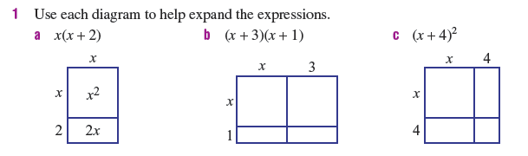
24
7
30
Expanding Algebraic Expressions
Date
EQ – How can I expand a binomial expression graphically?

Slide 10

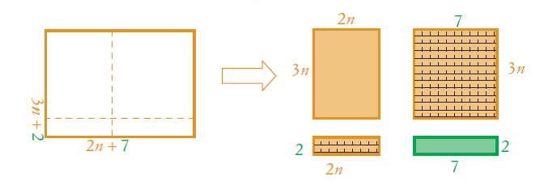
24
7
30
Expanding Algebraic Expressions
Date
EQ – How can I expand a binomial expression graphically?

Slide 11

24
7
30
Expanding Algebraic Expressions
Date
EQ – How can I expand a binomial expression graphically?

Slide 12
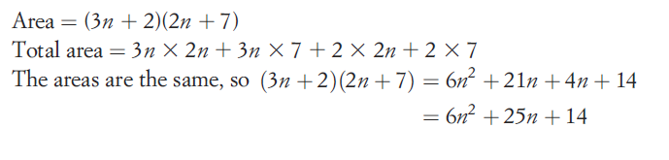
24
7
30
Expanding Algebraic Expressions
Date
EQ – How can I expand a binomial expression graphically?

Slide 13
24
7
30
Expanding Algebraic Expressions
Date
EQ – How can I expand a binomial expression graphically?
The Table method can also be used to expand binomial expressions

Slide 14
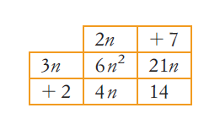
24
7
30
Expanding Algebraic Expressions
Date
EQ – How can I expand a binomial expression graphically?
The Table method can also be used to expand binomial expressions

Slide 15
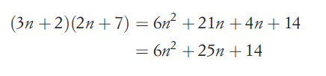
24
7
30
Expanding Algebraic Expressions
Date
EQ – How can I expand a binomial expression graphically?
The Table method can also be used to expand binomial expressions
Notes:
After this the students can break into groups to complete the tarsia’s, they can expand the terms using the distributive law, a table or graphically.

